Slide 1
DEC CENT NFT MARKETPLACE INT-219 FRONTEND DEVELOPMENT
NAME: JAKKAM PRAMOD KUMAR
REG.NO: 12104992

Slide 2
Introduction
HTML provides the basic structure of the web page, defining the layout and content
HTML is the skeleton of the webpage.
CSS is used to style the HTML elements, making them visually appealing and responsive.
CSS adds the style to the webpage.
JavaScript, often abbreviated as JS, is a versatile, high-level, and dynamically typed programming language that was initially developed for web browsers. It allows developers to add interactivity, manipulate the Document Object Model (DOM), and create rich, client-side web applications.
React.js comes into play when you need to build dynamic and interactive components within your web application

Slide 3
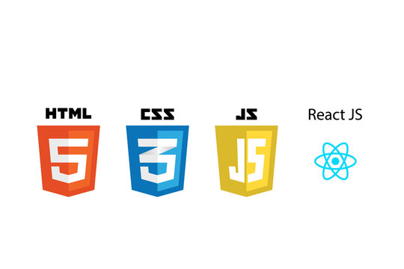
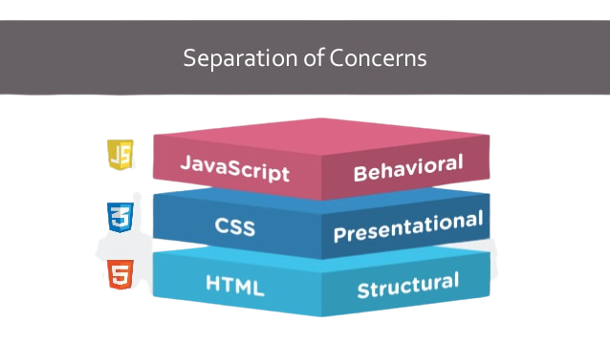
HOW IT STARTS

Slide 4
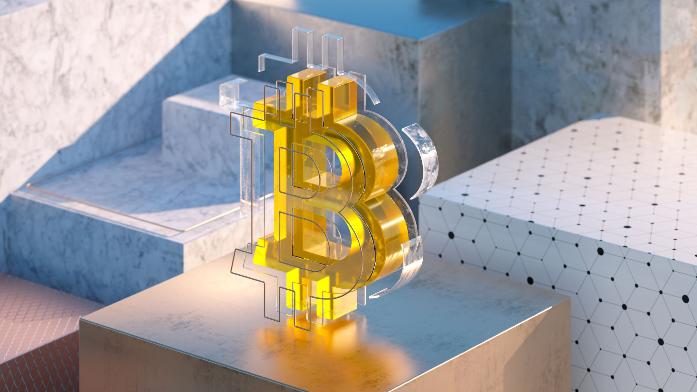
What are NFTs?
Non-fungible tokens (NFTs) are unique digital assets that represent ownership of items such as artwork, music, videos, and even virtual land. Unlike fungible tokens like Bitcoin, NFTs cannot be replicated or exchanged for one another. This makes them ideal for representing assets that have unique properties or value.
NFTs offer several benefits over traditional methods of ownership, including:
Authenticity, Ownership, Transparency, Fractional ownership

Slide 5
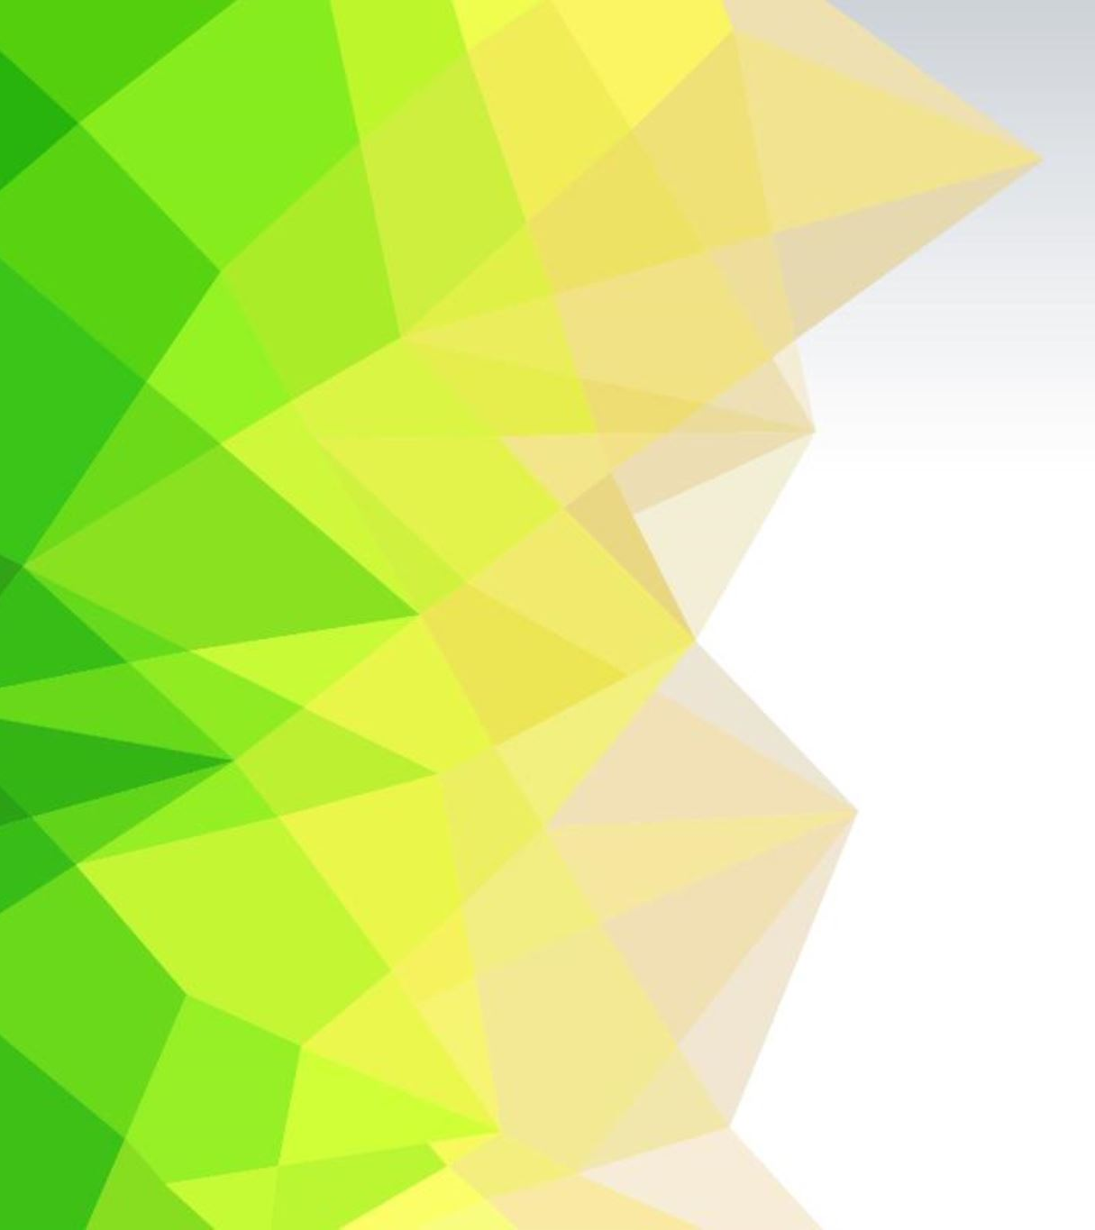
SCOPE OF STUDY
PROBLEM STATEMENT
The increasing popularity of NFTs has created a need for a comprehensive understanding of the market. This project aims to provide a thorough overview of the NFT ecosystem, including the different types of NFTs, the benefits and potential of NFTs, and the challenges and risks associated with NFTs.
Objectives
To provide an overview of the NFT market
To discuss the different types of NFTs
To analyze the benefits and potential of NFTs
To identify the challenges and risks associated with NFTs

Slide 6
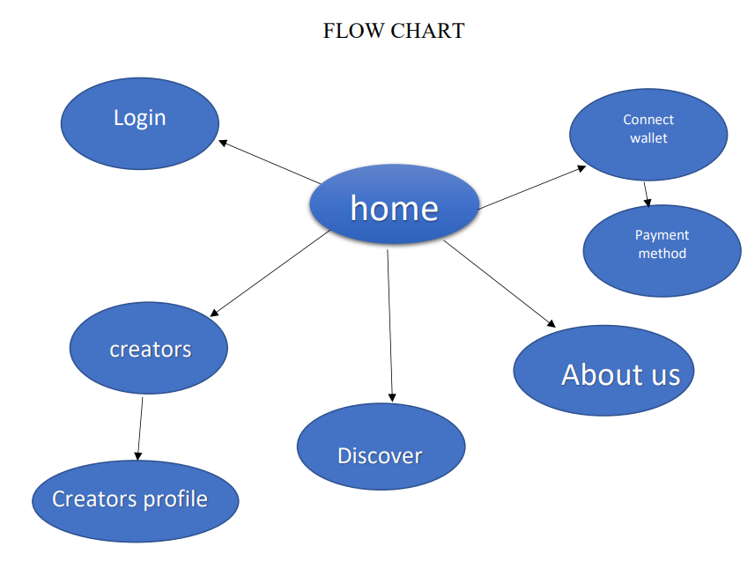
Brief of project
The website is designed in such a way that it is very user friendly and it is easily access able and it is easily manageable.

Slide 7
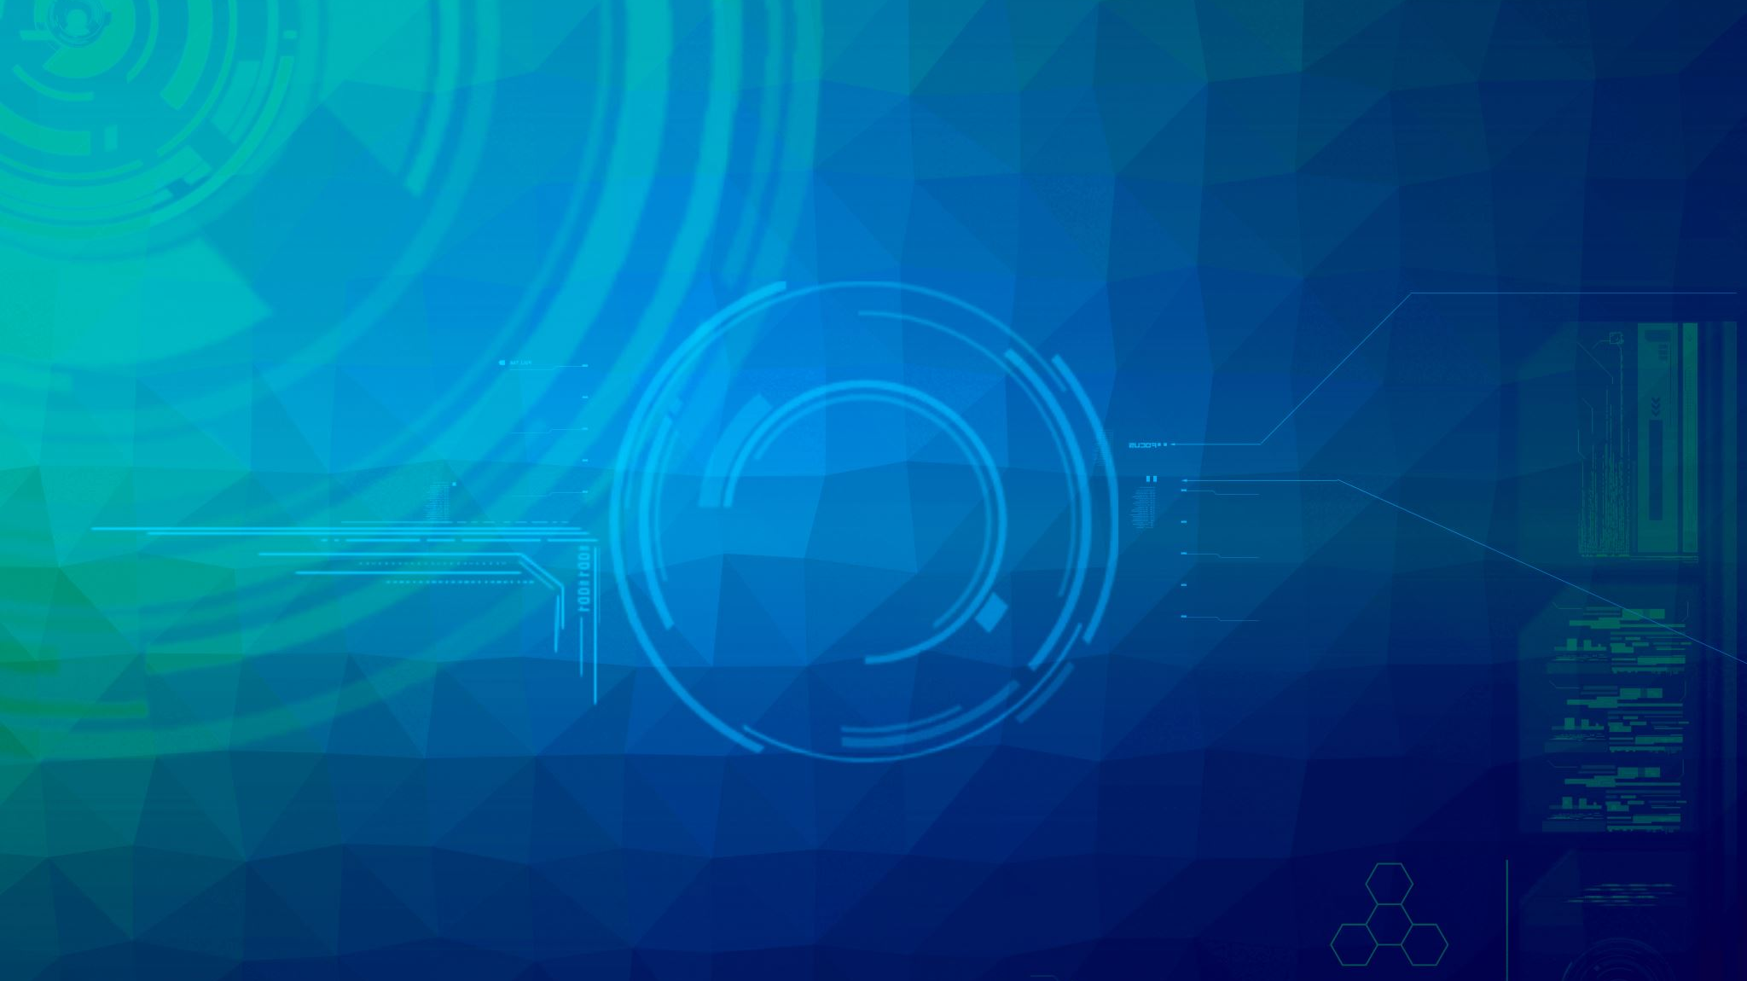
Implementation of project
In my website, the major purpose is a market place to list or showcase different kinds of digital nft’s at compact interface as possible. For the process of making it I had to brainstorm about my topic and gathered details about everything. I had some basic design ideas like hover colour change, buttons, colour templates, etc. Using designing tools I made some required designs for banner images. I made the overall use of html, css and javascript making it complete website.

Slide 8
Discover: It contains several modules they are discover where we can discover all the nft art collections its sale and price along with its seller or creator details from there we can get all types of collections available in the website.
Creators: It contains list of all the creators those who have registered and created and posted their assets for sale with their individual profile visibility
Connect Wallet: This contains the payment procedure if anyone want to buy the asset it has several modes on online payment through which we can pay money from it.
Contact us: This contains the details and procedure if anyone want to clarify any queries or contact us

Slide 9
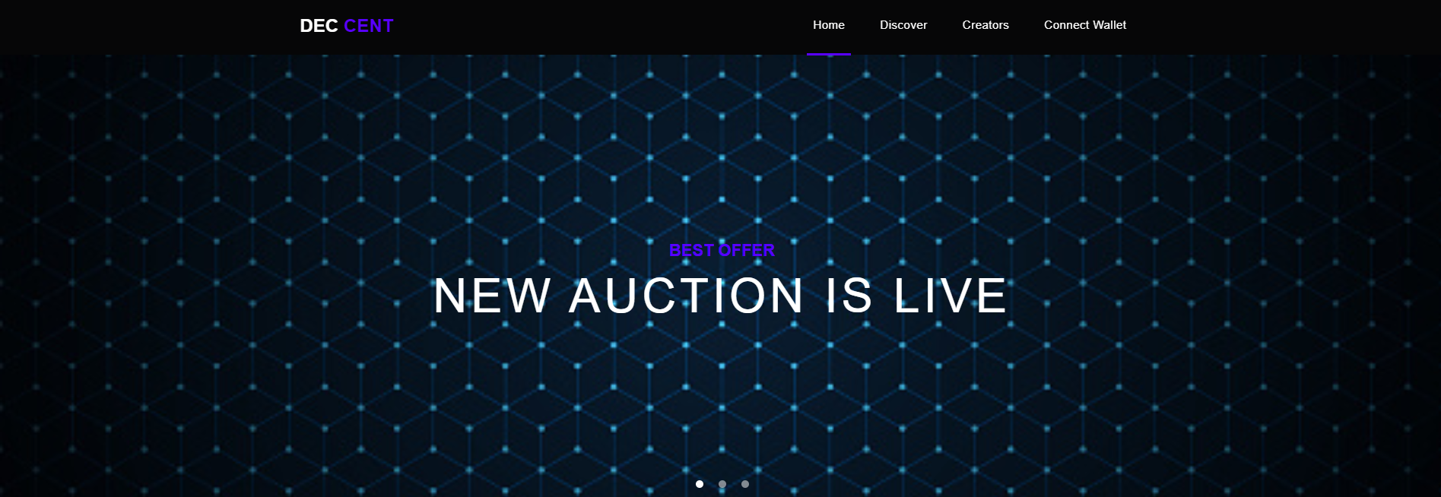
Screen shots

Slide 10
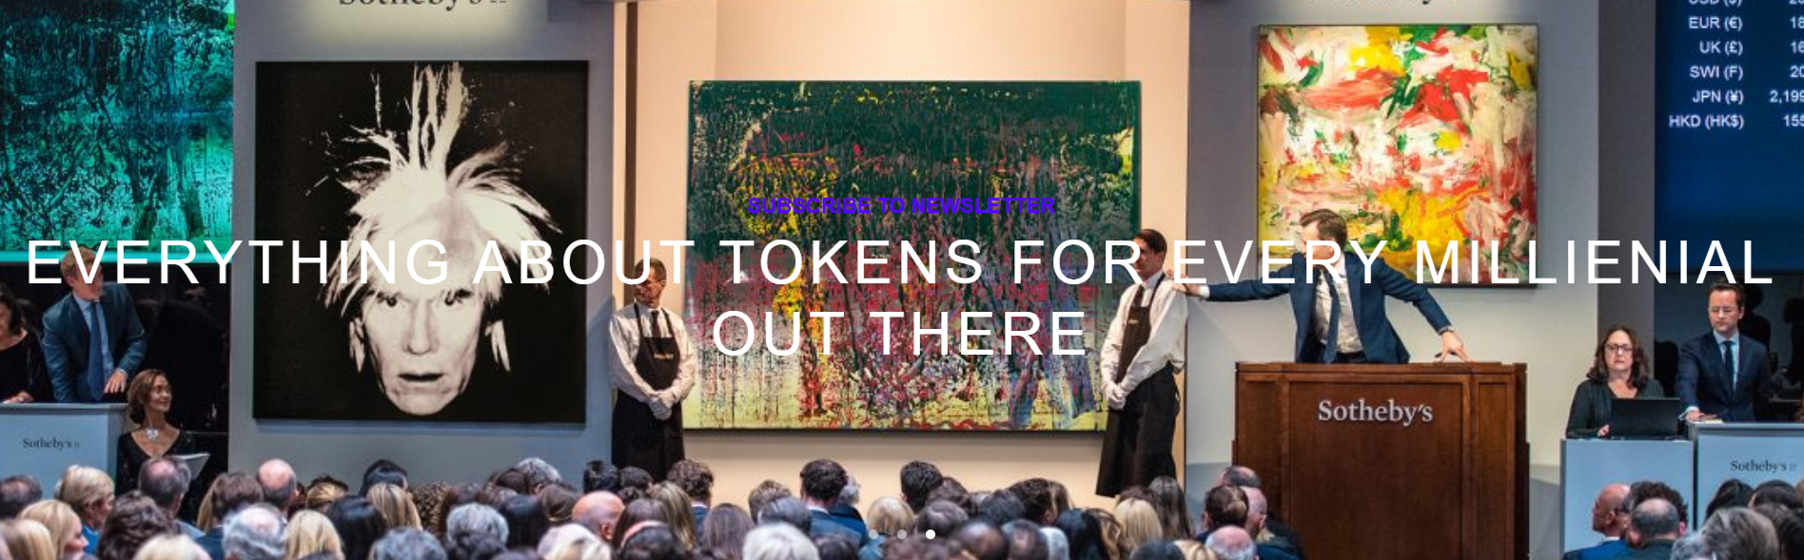

Slide 11
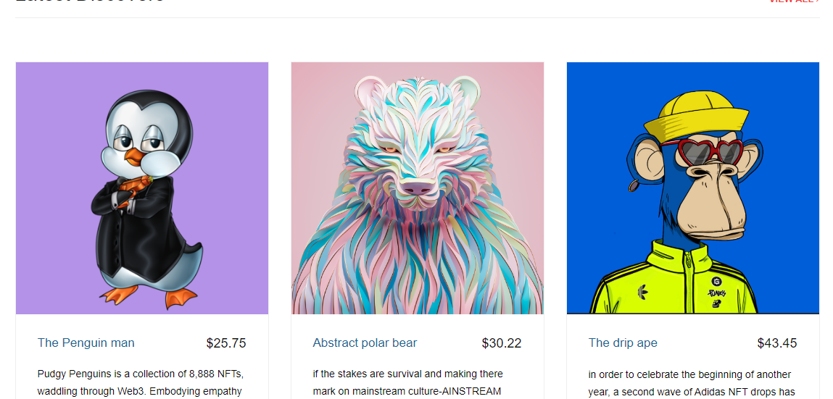

Slide 12
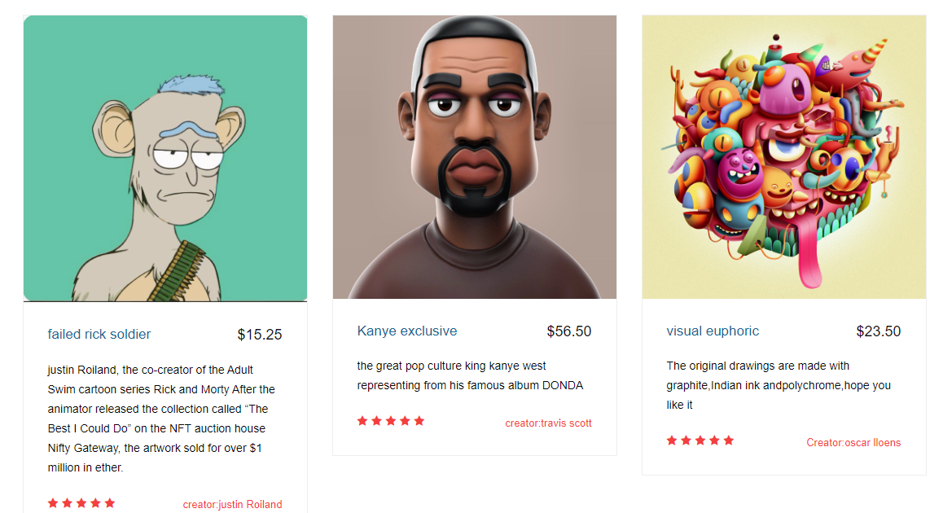

Slide 13
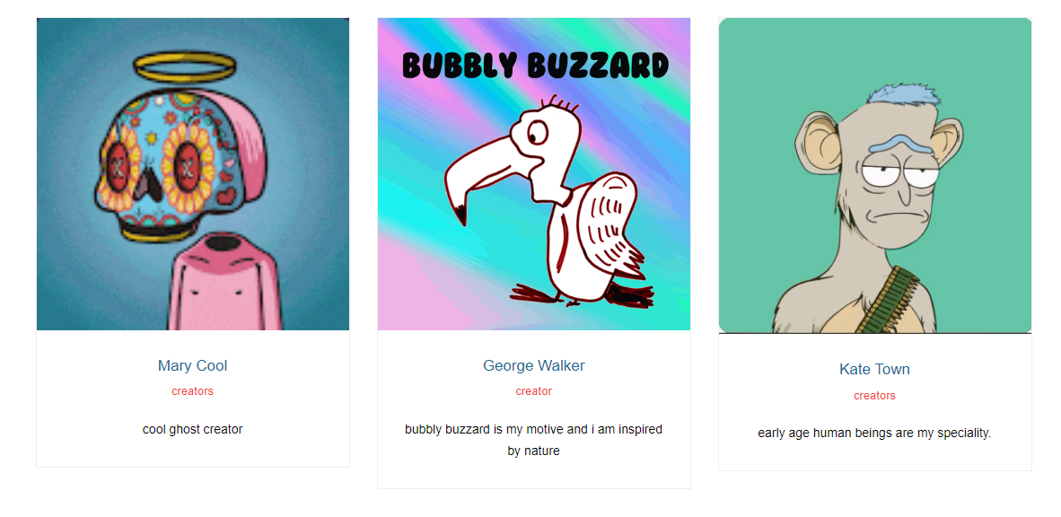
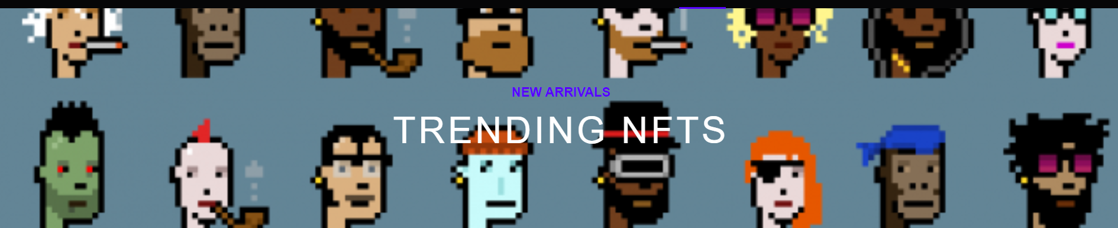
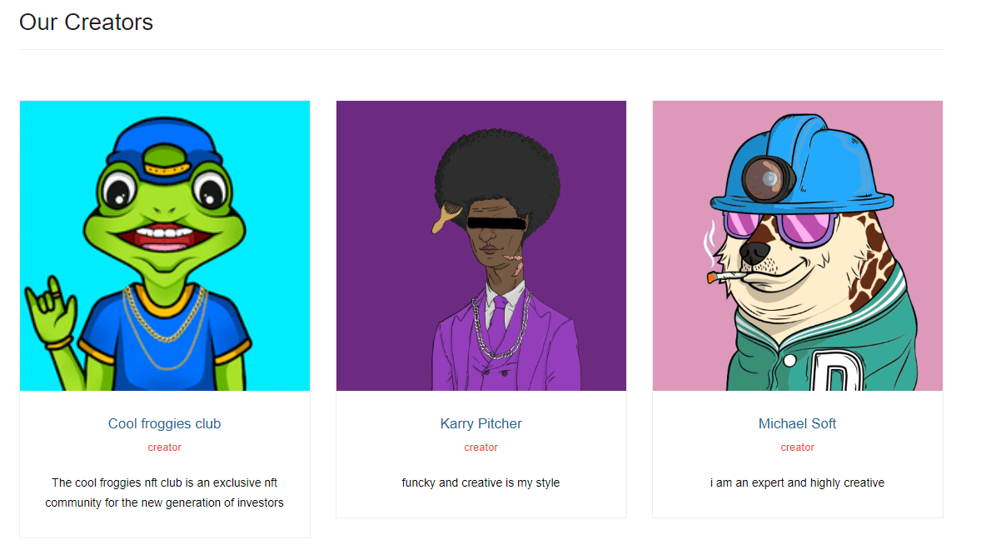

Slide 14

IMPLEMENTING THE PROJECT

